Slide 1
Linear Time Algorithms for Counting the Number of Minimal Vertex Covers with Minimum/Maximum Size in an Interval Graph
Min-Sheng Lin, Yung-Jui Chen
Information Processing Letters 107 (2008), pp. 257-264
Presenter : Hsiang-Yi Weng
Date : August 27, 2008

Slide 2
Abstract
This paper presents efficient algorithms
for an interval graph. These are an
algorithm for counting the number of
minimum vertex covers, and an algorithm
for counting the number of maximum
minimal vertex covers.

Slide 3
Interval Graph
A
D
7
F
4
5
6
B
G
1
2
3
C
E
7 無法放入
B
D
C
G
4
5
6
A
E
F
1
2
3

Slide 4
The Number of Minimal Vertex Covers with Minimum/Maximum Size in an Interval Graph
The number of minimal vertex cover with minimum size: 2
1
3
4
2
The number of minimal vertex cover with maximum size:1

Slide 5
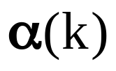
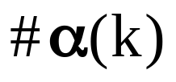

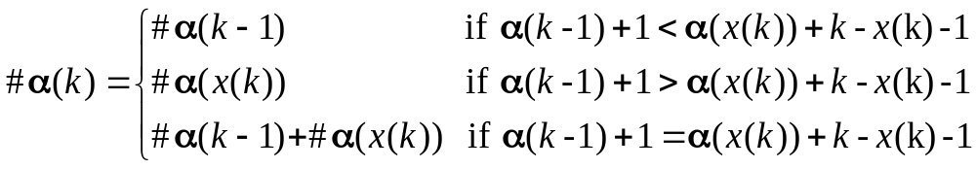
k | 1 | 2 | 3 | 4 | 5 | 6 | 7
x(k) | 0 | 0 | 2 | 1 | 0 | 3 | 5
y(k) | 0 | 0 | 2 | 2 | 2 | 3 | 5
 | 0 | 1 | 1 | 2 | 3 | 3 | 4
 | 1 | 2 | 2 | 3 | 3 | 2 | 5
2
4
6
1
7
5
3
2
4
5
10
12
14
3
11
1
6
7
8
9
13

Slide 6
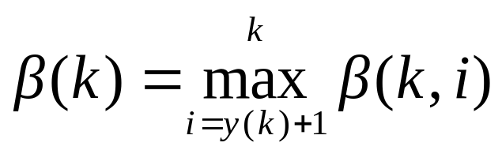
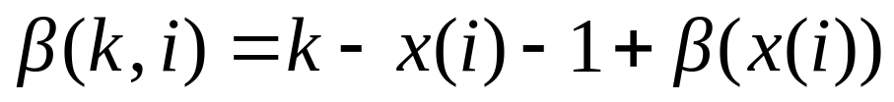
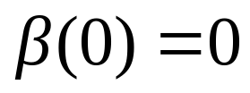
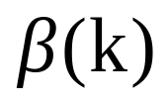
The Number of Minimal Vertex Covers with Maximum Size in an Interval Graph
1
3
4
2
k | 1 | 2 | 3 | 4
x(k) | 0 | 0 | 0 | 2
y(k) | 0 | 0 | 0 | 2
 | 0 | 1 | 2 | 3

Slide 7
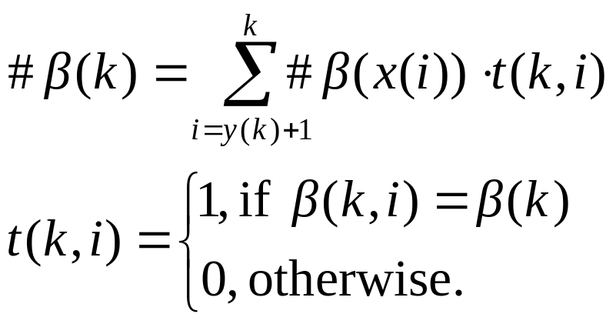
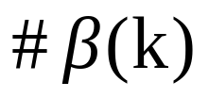
The Number of Minimal Vertex Covers with Maximum Size in an Interval Graph
1
k | 1 | 2 | 3 | 4
x(k) | 0 | 0 | 0 | 2
y(k) | 0 | 0 | 0 | 2
 | 0 | 1 | 2 | 3
 | 1 | 2 | 3 | 1
3
4
2

Slide 8
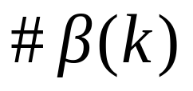
The Number of Minimal Vertex Covers with Maximum Size in an Interval Graph
利用double-ended queue
改進計算 時間 => O(n)

Slide 9
Summary of the results
Counting problems Chordal graphs Interval graphs
# of vertex covers O(n+m) O(n)
# of minimal vertex covers #P-complete O(n)
# of minimum vertex covers O(n+m) O(n)
# of maximum minimal vertex covers #P-complete O(n)

